Slide 1

Data Analytics Boot Camp - Final Project
1. Introduction
Airbnb is an online-based marketing company that connects people looking for accommodation (Airbnb guests) to people looking to rent their properties (Airbnb hosts) on a short-term or long-term basis. It includes all sort of properties, from apartments (dominant), homes, boats, and whole lot more. Founded 2008, Airbnb has steadily risen in terms of revenue growth and its range of service provisions. 150 million users as of 2019 in over 190 countries, making it a unique disruptor of the traditional hospitality industry. Airbnb revenue comes from a service charges to the hosts and the guests, a percentage of the total bookings. Hence Airbnb generates a lots data such as density of rentals across regionals; cities and neighborhoods, price variations across rentals, reviews of guest-host interaction, and more.
New York city (NYC) is one of the very active Airbnb market with more than 45,000 listings as of last quarter of 2019 calendar year. This project focuses on just a small amount of patterns and other relevant information about Airbnb listings in NYC.

Slide 2
2. Data Set
The data was downloaded from Inside Airbnb: http://insideairbnb.com The data set that was employed was named ab_nyc_2019, it is a detailed data set with 16 attributes, a few of the attributes being: prices, neighborhoods , number of bedrooms, property type, neighborhood group, number of reviews, host's name (not used), etc. The data contains a total of 48000+ I dropped few columns that were not needed for this project. This reduced the number of data to 38,837.
3. Exploratory Data Analysis
Initially explored the data and cleaned to the desired columns to gain good understanding of the data distribution, and here are few of the visual representations;

Slide 3
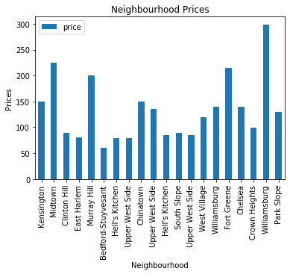
Figure 1: Depiction of the prices of the rental property related to the neighborhood.
Clearly the neighborhood dictates the rental prices in NYC.

Slide 4
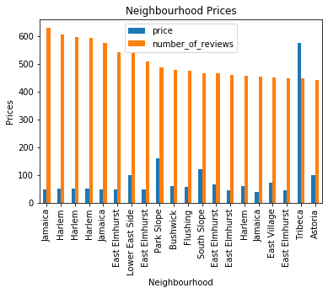
Figure 2: Depiction of the neighborhood, the number of reviews in relations to the prices
This depicts the impact of the # of reviews have on the rental prices.

Slide 5
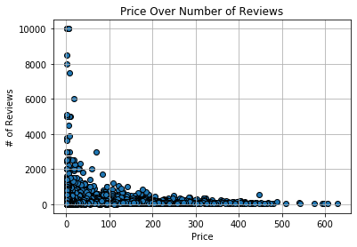
Figure 3: Depiction of the prices of the rental property over number of reviews.
Clearly the # 0f reviews dictates the rental prices in NYC.

Slide 6
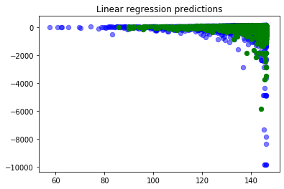
Machine Learning
plt.scatter(predict_train, predict_train - y_train, c = "b", s=40, alpha=0.5)
plt.scatter(predict_test, predict_test - y_test, c = "g", s=40)
plt.title("Linear regression predictions")
plt.savefig('linear regression predictions.png')

